Slide 1
zekeLabs
Spark - Storage Data Formats
Learning made Simpler ! www.zekeLabs.com

Slide 2
What storage format did Spark use?
Storage format evolution over a period of time
Agenda

Slide 3
What storage format did Spark use ?
Spark 1.0 to 1.3: It started with RDD’s where data is represented as Java Objects.
Spark 1.4 to 1.6: Deprioritised Java objects. DataSet and DataFrame evolved where data is stored in row-based format.
Spark 2.x: Support for Vectorized Parquet which is columnar in-memory data is added.

Slide 4
Evolution of Storage Format
Advancement from RDD to Row-based Dataset.
From Row-based Dataset to Column-based Parquet.

Slide 5
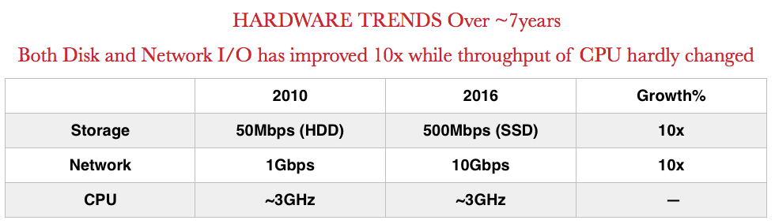
Advancement of RDD to Row-based Dataset.
Objective was to optimize - memory & cpu.
Serialization & hashing which are CPU bound

Slide 6
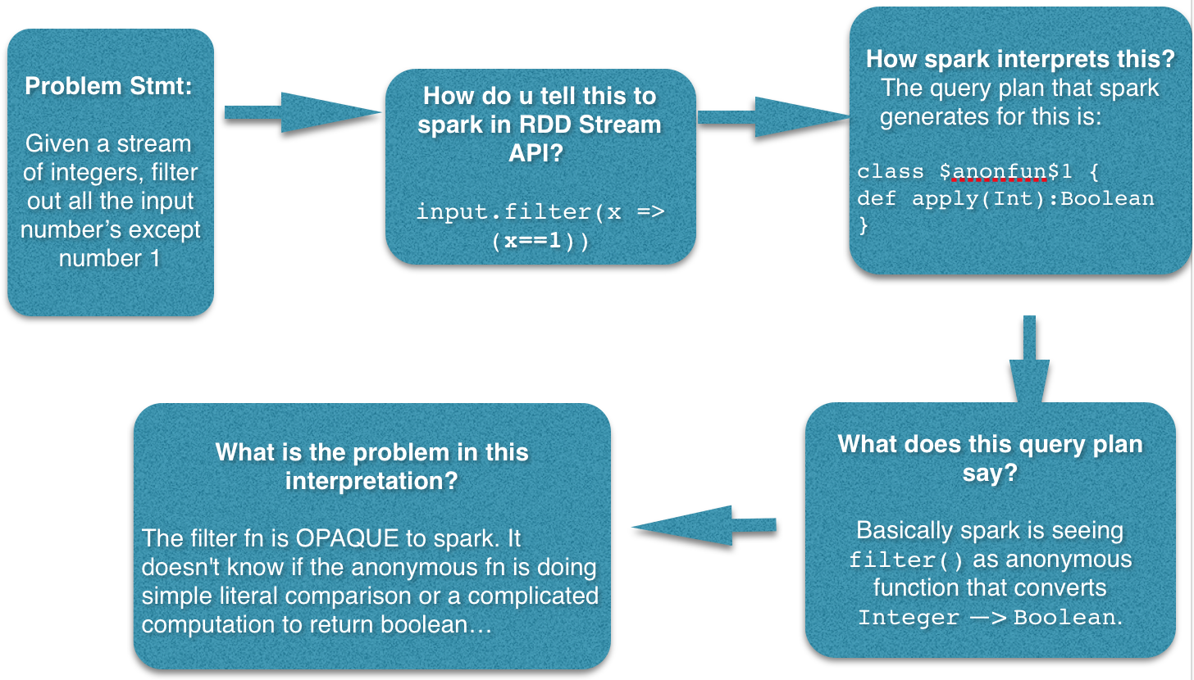
Problem - Invisible Schema

Slide 7
Lack of transparency to optimize
What operations user is trying to do on data ?
What is the type of data ?
What transperancy does Spark need ?
Data Schema
User Operation

Slide 8
Action Plan
Have user register dataschema
Perform ops on data transparent to Spark

Slide 9
Problem - Reduce memory footprint
With RDD’s data is stored as Java Objects.
There’s a whole lot of serialisation, deserialisation, hashing and object creation that happens whenever we want to perform an operation on these java objects’s and during shuffles.
Apart from this Java objects have large overheads.

Slide 10
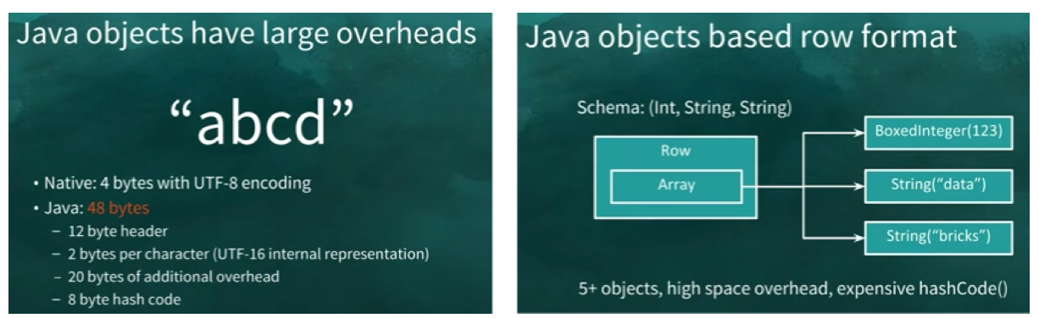
Overhead

Slide 11
Action Plan Improved
Have user register dataschema
Perform ops on data transparent to Spark
Create a data layout which is more compact & less overhead.
The above action plans led to “DataFrames & Datasets”

Slide 12
DataSet/DataFrame
A Dataset is a strongly-typed, immutable collection of objects with 2 important changes that spark introduced as we discussed in our action plan:
Introduced new Binary Row-Based Format
Data Schema Registration

Slide 13
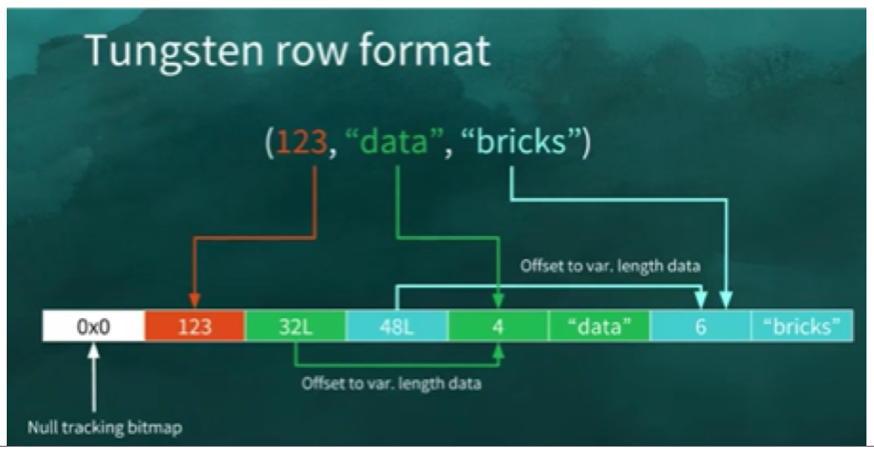
Tungsten row format

Slide 14
Conversion of dataset to tungsten format
Spark provides Encoder API for DataSet’s which is responsible for converting DataSet to spark internal Tungsten binary format and vice-versa.
A less obvious advantage with Encoders: Encoders eagerly check that your data matches the expected schema, providing helpful error messages before you attempt to incorrectly process TBs of data

Slide 15
Benefits of Dataset's
Encoders eagerly check that your data matches the expected schema, providing helpful error messages before you attempt to incorrectly process TBs of data
Possible in-place transformations for simple one’s without the need to deserialise.
Reduce our memory footprint significantly.
Spark knows what data is it handling now.

Slide 16
In-place Transformation
What happens in RDD
Its first deserialized into java object
We apply the transformation operation on JavaObject and
Finally serialize javaobject back into bytes.
With Dataset’s, in-Place Transformation essentially means that, we need not deserialize a dataset to apply a transformation on it.

Slide 17
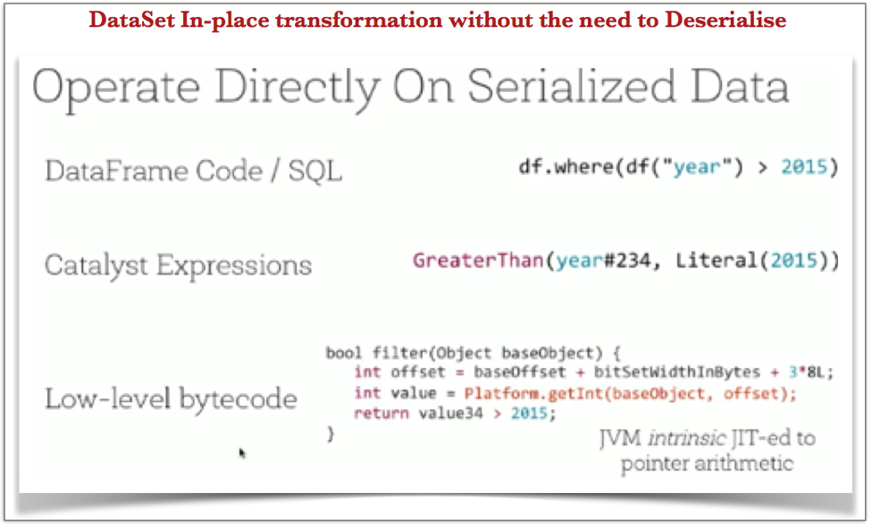
In-place transformation in dataframe/dataset

Slide 18
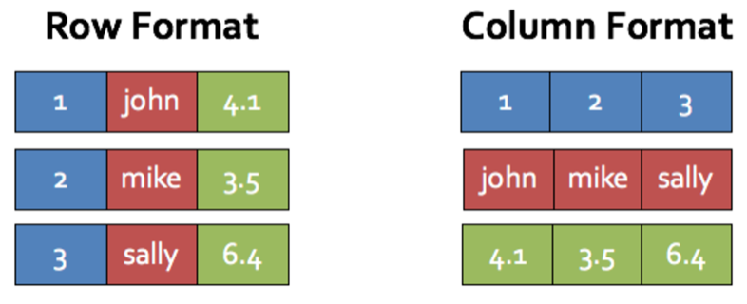
Row-based Dataset to Column-based Parquet

Slide 19
Why columar ?
Tweaked its execution engine to perform vector operations and attained data level parallelism at algorithm level
Spark moved from row-based to columnar in-memory data enabling themselves for further SIMD optimisations like data striping for better cache and other advantages listed below.

Slide 20
Benefits of columnar storage
Regular data access vs Complicated off-set computation
Denser storage
Compatibility and zero serialization
Compatibility with in-memory cache

Slide 21
Thank You !!!

Slide 22
THANK YOU
Let us know how can we help your organization to Upskill the employees to stay updated in the ever-evolving IT Industry.
Get in touch:
www.zekeLabs.com | +91-8095465880 | info@zekeLabs.com
Visit : www.zekeLabs.com for more details

